Slide 1
Multi-level madness?
ERIN CARY
Build Capacity and Develop Future Teachers by Creating Teaching Internships
Lyndale Education Program

Slide 2
Objectives:
one
Discuss our classroom challenges & how teaching internships can help us address them
two
Review expectations for a teaching intern and their supervisor
three
Consider how to adapt this model to boost teaching capacity in your context

Slide 3
Who are we?
One-room schoolhouse?
Multi-level group that you routinely differentiate?
Multi-level group that you feel you WANT to differentiate more?

Slide 4
What are the challenges?
Students not receiving enough teacher attention
Insufficient time for one teacher to plan leveled lessons for several groups
Teacher wherewithal and classroom organization
Lack of funding for additional instructors (for the moment)

Slide 5
Expectations of teaching intern
Commit to term and weekly time commitment of internship
Take on necessary duties and activities required by internship
Agree to absence policy

Slide 6
Expectations of teaching internship supervisor
Set objectives for intern and organization
Organize and set schedule for internship activities
Supervise and check in with intern continually
Provide curriculum and instructional/planning support; share industry knowledge
Conduct teaching observation and provide feedback; supply professional reference

Slide 7
A few considerations to, um… consider
FIT
Be pickier in your intern selection process than with a normal volunteer, because:
You want this to increase your capacity, not overwhelm you with piles of support work
Intern should be someone you’re comfortable asking your students to learn from

Slide 8
A few considerations to, um… consider
FIT
Your intern should ideally have some teaching background and/or education OR really proven instincts. They should be very professional and make students feel at ease.
If there’s someone great in your existing volunteer pool who might be interested, approach them!

Slide 9
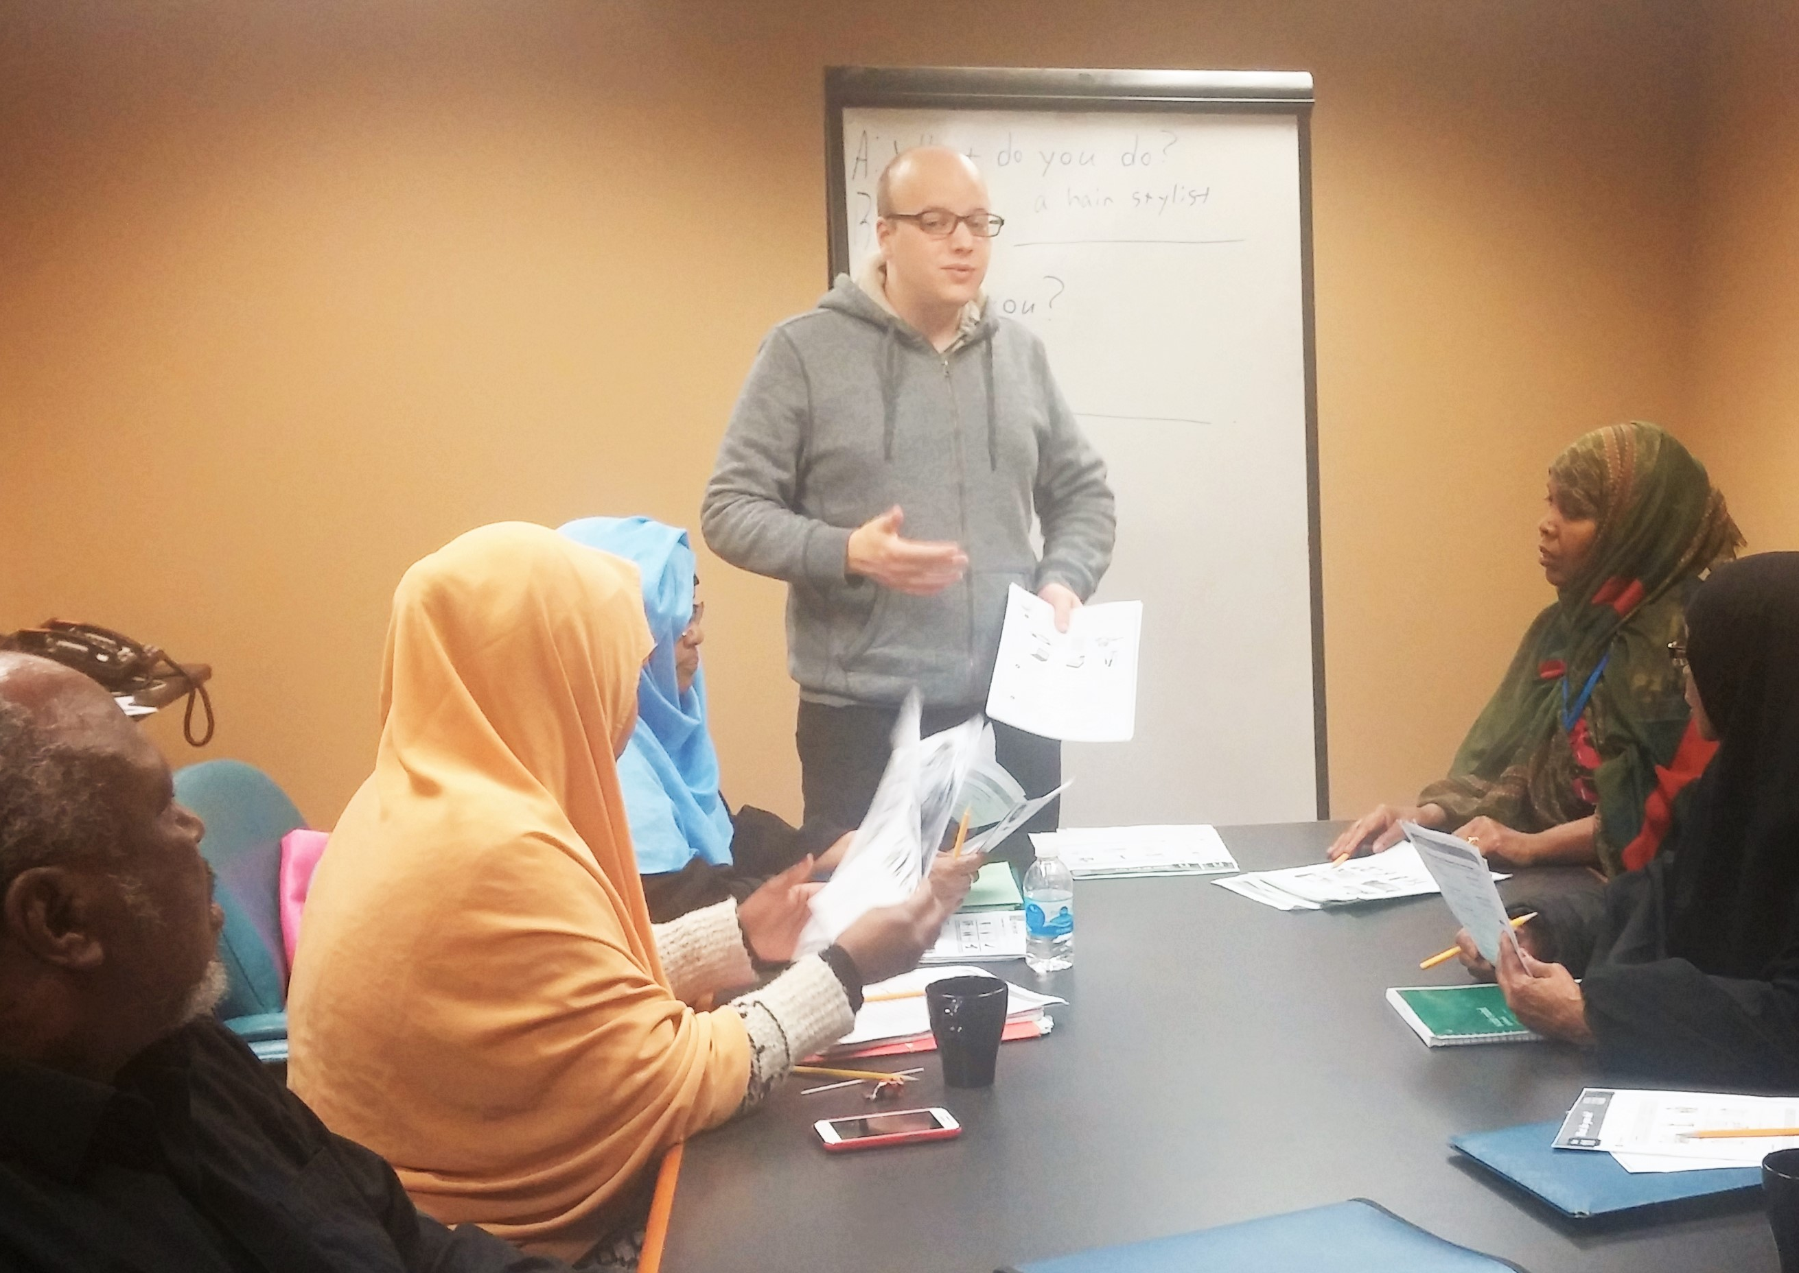
FIT
Kyle Polman-Biittner:
CELTA certificate; teaching experience in South Korea; flexible schedule; potentially interested in working in adult literacy
Philomena Kemsley:
Former children’s speech pathologist for NHS in London; flexible schedule; seeking new career without investing immediately in another degree

Slide 10
A few considerations to, um… consider
LOGISTICS
You’ll need dedicated time & space to meet with your intern for check-ins
Your intern needs access to instructional resources and printing/copying
Try to be flexible with the length and intensity of commitment within your internship in order to attract a great candidate

Slide 11
A few considerations to, um… consider
ETHICS
Adam Ruins Everything
“Why Most Internships Are Actually Illegal”

Slide 12
A few considerations to, um… consider
ETHICS
Build your internship as a supervised experience that allows someone to learn about and gains experience in our industry through lesson planning, classroom instruction and collaboration with an ABE professional.
PAY YOUR INTERN, or if they are a student and can arrange college credit, this experience can serve as field training. Lends a level of professionalism to your position (and unpaid internships are B.S.)

Slide 13
Discuss with a neighbor (or two):
How could this model solve problems in your context?
What aspects of the internship would need to be adapted for your context? What would those adaptations look like?
Who would supervise the intern?
Other concerns?

Slide 14
Questions? Comments? Thoughts?
Materials and Powerpoint available at teachinginternships. weebly.com

Slide 15
Thank you for joining me for the last session of Summer Institute 2016!
Safe travels home, everyone!

